Slide 1
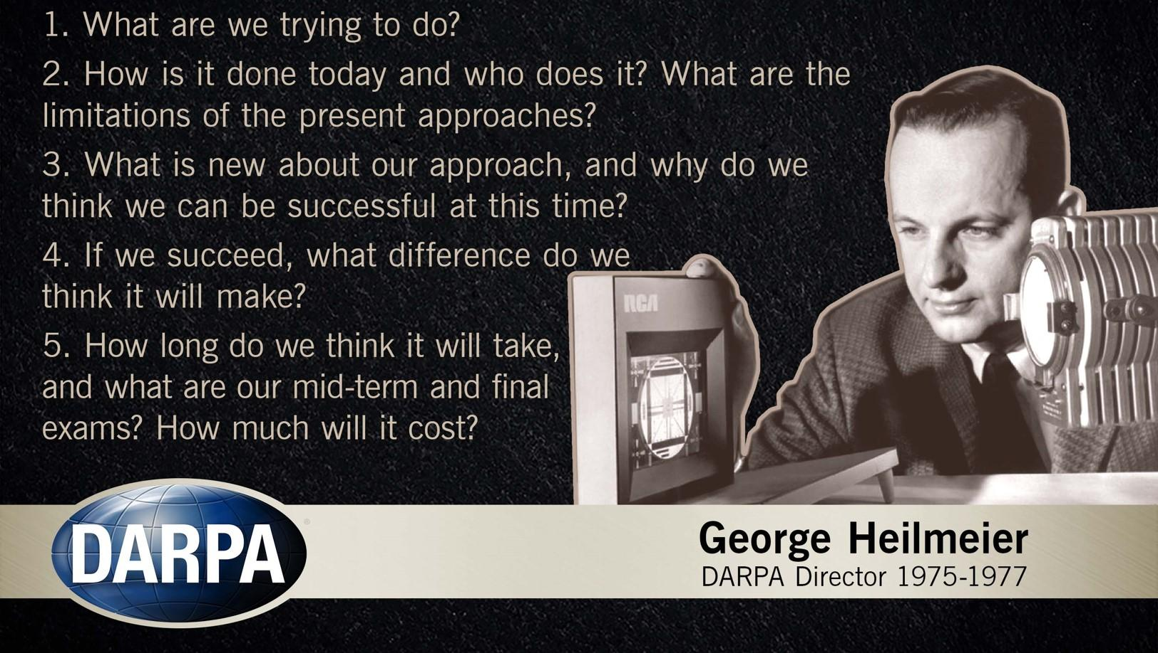
Team B2 – Leonardo Da Pinchy
Bryan Hong, Aaron Tang, Jonathan Waller
`
Add your 10 slides after this slide… [remember, 10 min talk + 2 min Q/A]
For more information about formatting or importing slides see:
https://gsuite.google.com/learning-center/products/slides/get-started/
Make sure to cover
(refer to the Proposal Presentation Guidance):
Use Case - Who is your customer, what product do they want to buy?
Use-Case Requirements - What do they expect your product to do? [Answer this Quantitavely]
Technical Challenges - What do you need to technically achieve so your product can meet these requirements?
Solution Approach - Show us step by step what your proposed solution path(s) looks like – incorporate flow diagrams
Testing, Verification and Metrics – Detail your testing & verification plan (and how you will measure & verify the results) of your product
Tasks and Division of Labor - Technical Task List to build your proposed system, WHO is going to do WHAT in your team?
Schedule - Gantt Chart (task timeline, demo system/components, MVP, stretch goal, include slack time)
Consider that this slide already works as a introduction slide so use your first slide wisely
Remember – Relevant figures (and tables) can be worth
“a thousand words”!

Slide 2
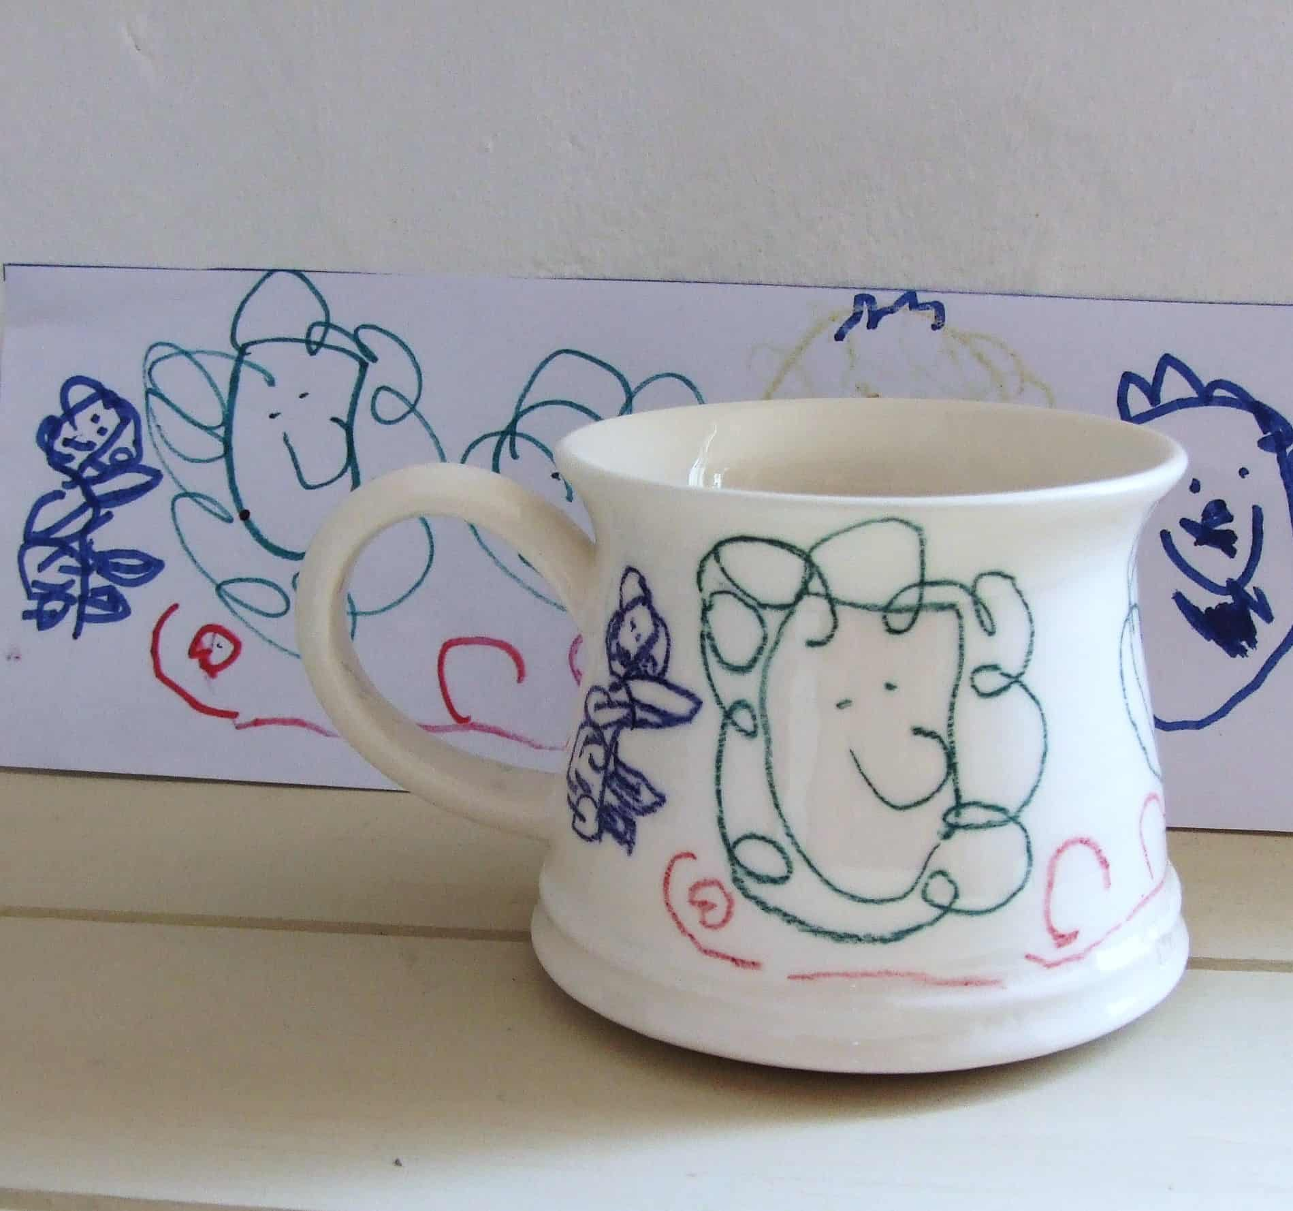
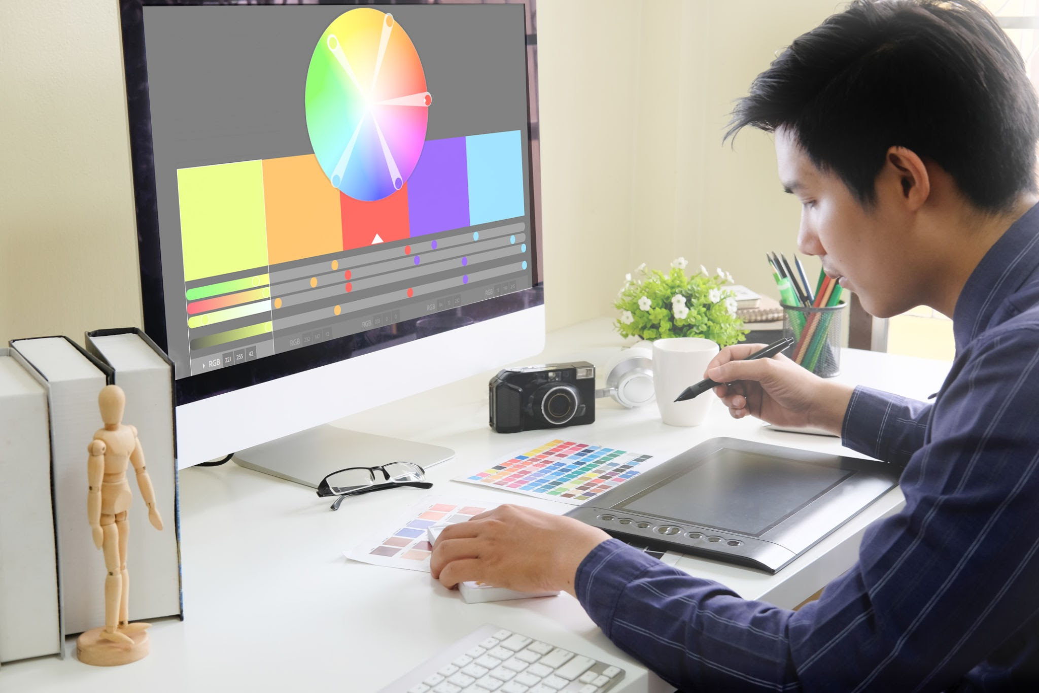
User Story
Digital artist and business owner Leonardo creates custom ceramic mugs
Leonardo makes his designs digitally
Redoing every design on each mug is time consuming at scale
He wants a robotic solution that allows him to produce mugs en masse

Slide 3
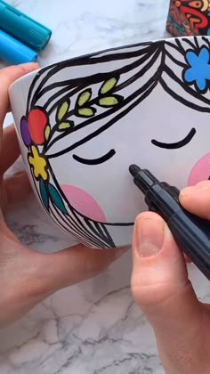
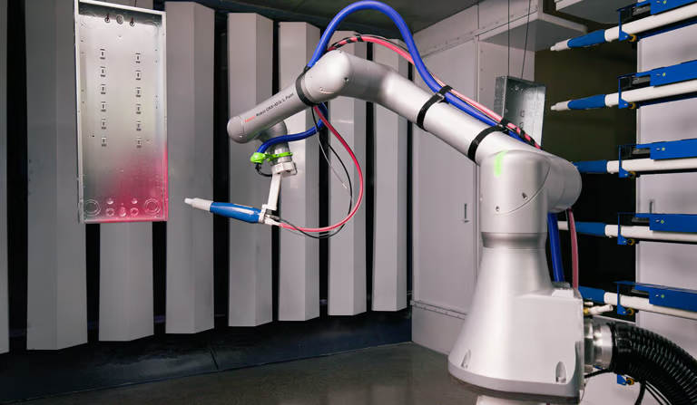
Use Case
Reproducing digital art on non-planar surfaces where using standard CNC machines with 3 DoF is difficult
Often, problems with printing are:
Lack of stroke depth, colors, and fluidness
Robots have a difficult time adjusting to surfaces it’s not familiar with
Our robot should successfully replicate a piece of submitted art on a fixed non-planar surface whose dimensions we know.

Slide 4
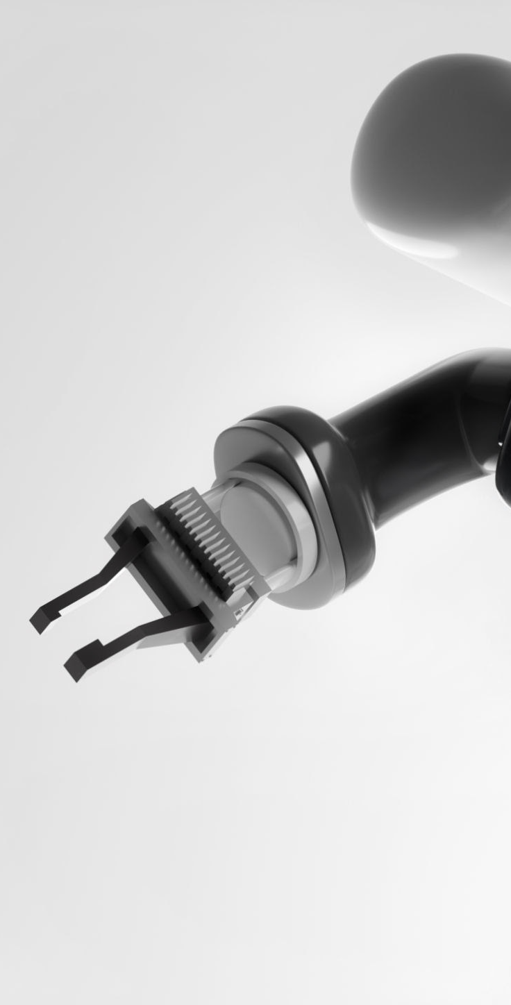
Use-Case Requirements (1/2)
Requirement | Target | Justification
Target specifications | One surface; shape, curves, and dimensions known | Keeps the testing surface bounded.
Drawing area | Predefined, with front section reachable only | Avoid collisions and unreachable back surfaces.
Drawing surface alignment | Camera + fixture reference; set distance from target | Place the target consistently in a fixed location in front of the robot.
Working area | 0.4 × 0.4 × 0.4 m | Allow space for the target, holder and pen motion.

Slide 5
Use-Case Requirements (2/2)
Requirement | Target | Justification
Drawing format | SVG vector paths | Preserve digital strokes for mapping onto the curved surface.
Line accuracy | Target ≤2.00mm surface-path error; statistic TBD | Keep outlines useful for subsequent carving or painting.
Input limits | 2 colors; 50 strokes; 100 cm combined path | Support small patterns while bounding job complexity.
Pen orientation | Proposed 6-DOF arm | Adjust pen position and angle along the known curve.

Slide 6
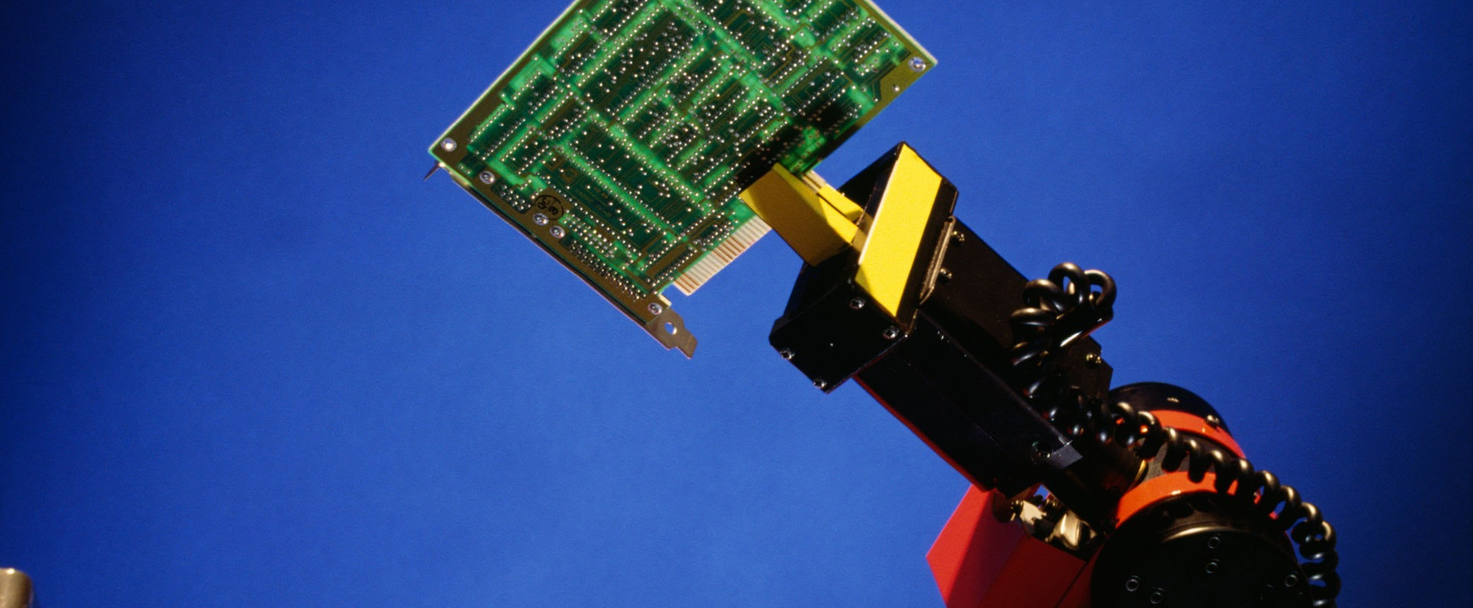
Technical Challenges
Challenge | Requirement | Proposed response
Weight of arm | Arm needs needs to be able to draw without falling over | Install heavy counterweights at the base, or bolt the arm to a rigid fixture
Target position / rotation | Consistent design detection | Fixed location + April tag for manual calibration of (0, 0)
Marker contact | Maintain contact during curved motion | Spring-loaded holder; force sensing
Marker pickup | At least 90% swap success | Fixed rack; gripper; tip calibration
Reach / orientation | Reach / handle clearance | Front arc + collision checks; rotation later
Degrees of Freedom | 6-DOF | Calculate curved path; adjust pen angle

Slide 7
Proposed Solution
External
Computer
Jetson
Nano
User’s Interface
External Cameras
User Image
Browser UI
Robot Arm
Robot execution
Robot Arm Path Construction
Servo motor gripper
Stepper motor joints
Surface position
and dimensions
Scale and transpose 2d points onto the surface in 3d points
Marker positions
Power Bank
Microcontroller
Inverse kinematics + Cartesian Path Interpolation
(Create the current drawings full path)
Motor control
firmware
Inputs
ROS2 Path Execution
Software
Hardware
Output

Slide 8

1
2
3
4
Object/Surface Calibration
Marker ID and Selection
Coordinate Algorithm Testing
Pen Orientation
Testing and Verification
Procedure: Use AprilTags (QR codes) and external camera for calibration
Metrics:
Calculate error (cm) between calculated origin and intended origin
Ideal error ≤ 2 mm
Procedure:
Use external camera + CV model to pick out desired marker color
Metrics:
Calculate accuracy of selecting correct color marker
Ideal accuracy ≥ 90%
Procedure:
Have robot draw over predetermined printed image
Metrics:
Calculate maximum error (mm) between printed and drawn image
Ideal error ≤ 2 mm
Procedure:
Test roll, pitch, and yaw DOFs while drawing on flat surface
Metrics:
Calculate maximum roll, pitch, and yaw angles
Ideal yaw ≅ 60°
Ideal pitch ≅ 60°
Ideal roll = 360°

Slide 9
Tasks & Division of Labor
Owner | Workstream | Deliverables
Jonathan Waller | Embedded / hardware | Arm, mug holder, gripper, controls; rotary stage later
Bryan Hong | Circuits | Power, drivers, sensor circuits, hardwired stop
Aaron Tang | Software / modeling | Mug alignment, curved SVG paths, kinematics, web UI
All three | Integration / tests | Mug drawing, placement and contact tests

Slide 10
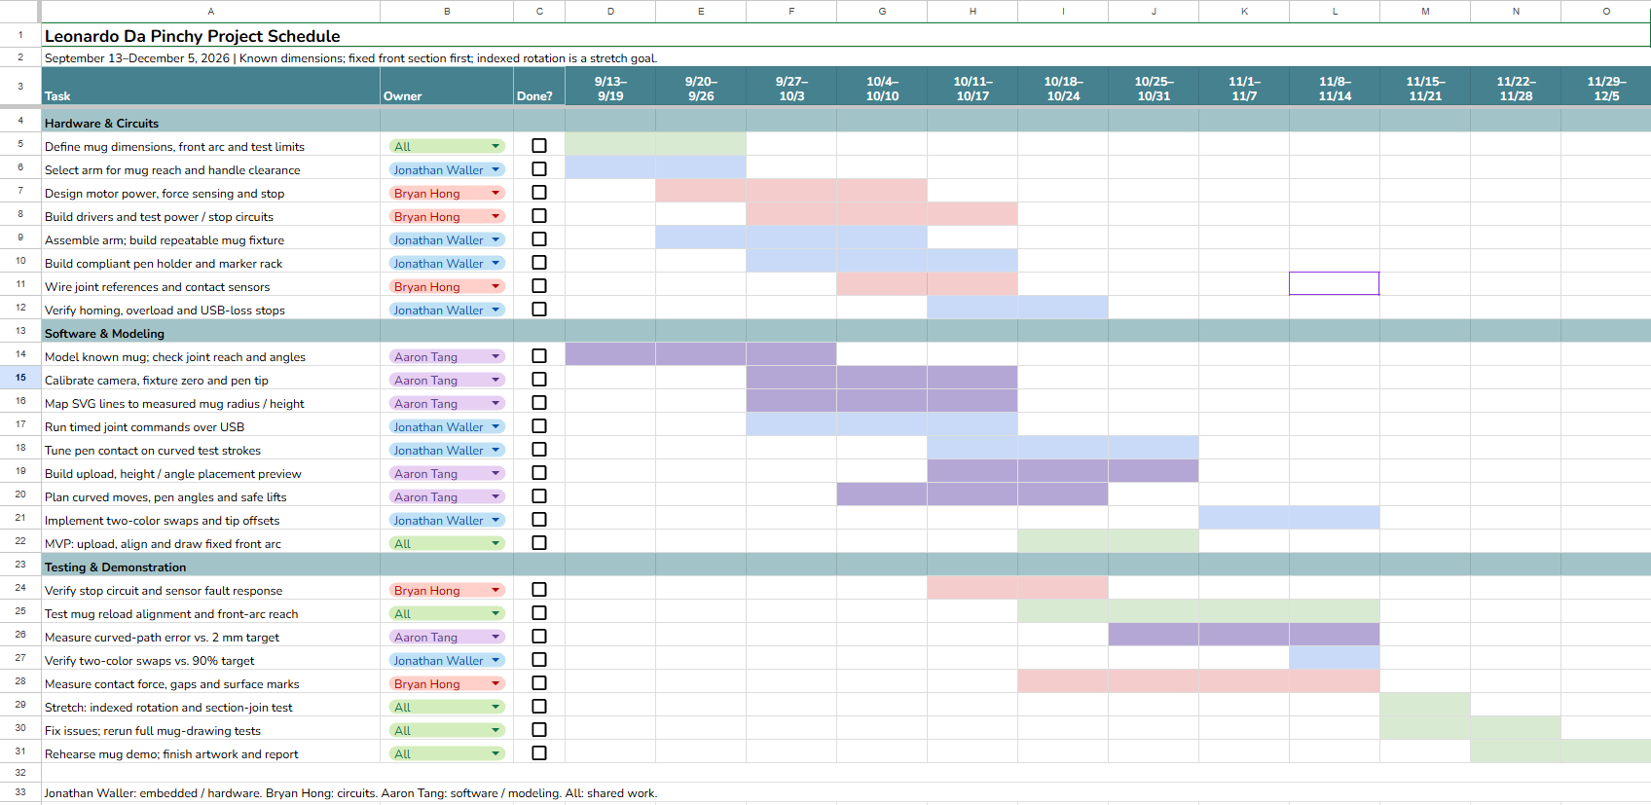
Schedule & Demonstration Milestones

